Slide 1
Observability and Troubleshooting
Health and Status Checks
Logging, Auditing, and Troubleshooting
SoftUni Team
Technical Trainers
Software University
https://about.softuni.bg

Slide 2
Have a Question?
sli.do
#Kubernetes
https://www.facebook.com/groups
/KubernetesOctober2021
Notes:
2

Slide 3
Homework Progress
Submit M3 until 23:59:59 on 05.11.2021
Submit M4 until 23:59:59 on 12.12.2021
Submit M5 until 23:59:59 on 19.12.2021
Submit M6 until 23:59:59 on 26.12.2021

Slide 4

Previous Module (M5)
Quick overview

Slide 5
Table of Contents
Static Pods and Multi-container Pods
Autoscaling and Scheduling
Daemon Sets and Jobs
Ingress Resources and Controllers
5
Notes:
5

Slide 6

This Module (M6)
Notes:
6

Slide 7
Table of Contents
Health and Status Checks
Auditing and Logging
Troubleshooting
7
Notes:
7

Slide 8
Health and Status Checks
Notes:
8

Slide 9
Health and Status Checks
Periodic checks executed by the kubelet against containers
Those checks are known as probes
They can be liveness, readiness, and startup probes
Their status can be either Success, Failure, or Unknown
Used for a better control over the container and pod lifecycle and better integration with other objects
https://kubernetes.io/docs/tasks/configure-pod-container/configure-liveness-readiness-startup-probes/

Slide 10
Check Methods
Each probe type can use either Exec, HTTP, or TCP method
Exec is used to exec a specified command inside the container. It is considered successful if the return code is 0
HTTP makes a GET request against the pod’s IP address on a specified port and path. It is considered successful if the status code is between 200 and 399
TCP performs a check against the pod’s IP address on a specified port. It is considered successful if the port is open
https://kubernetes.io/docs/tasks/configure-pod-container/configure-liveness-readiness-startup-probes/

Slide 11
Liveness Probes (livenessProbe)
Indicate whether a container is running
If it fails, then kubelet kills the container
After that, the container is subject to the restart policy
It can be Always, OnFailure, and Never. The default is Always
The restart policy is defined on pod level and applicable to all containers in the pod
If no liveness probe is provided it is considered as if it was there and the return status is Success

Slide 12
Readiness Probes (readinessProbe)
Indicate whether a container is ready to respond to requests
If it fails, then the endpoints controller removes the pod’s IP address from the endpoints of all services that match the pod
A pod is considered ready when all its containers are ready
The default state, before the initial delay is Failure
If no readiness probe is provided it is considered as if it was there and the return status is Success

Slide 13
Startup Probes (startupProbe)
Indicate whether the application in the container is started
If it fails, then kubelet kills the container
After that, the container is subject to the restart policy
All other probes are disabled if a startup probe is present until it succeeds
If no startup probe is provided it is considered as if it was there and the return status is Success

Slide 14
Common Fields
initialDelaySeconds sets the number of seconds to wait before a probe to be initiated. Defaults to 0 with minimal value of 0
periodSeconds sets how often (in seconds) a probe to be performed. Defaults to 10 with minimal value of 1
timeoutSeconds sets the number of seconds before a probe times out. Defaults to 1 with minimal value of 1
successThreshold sets the minimum consecutive successes for a probe to be considered successful after a failure. Defaults to 1 with minimal value of 1
failureThreshold sets the number of times for Kubernetes to try failing probe before giving up (for liveness – restart, for readiness – unready). Defaults to 3 with minimal value of 1
https://kubernetes.io/docs/tasks/configure-pod-container/configure-liveness-readiness-startup-probes/#configure-probes

Slide 15

Practice
Live Exercise in Class (Lab)
Notes:
15

Slide 16
Auditing
Notes:
16

Slide 17
Auditing
Actions in the cluster are captured in chronological order
They can be initiated by the users, applications, or control plane
Answers who did what and when on what and what happened
Audit records begin their existence in the kube-apiserver
Each request on each stage of its execution generated an event
It is pre-processed according to the policy and send to a backend
Following stages are available RequestReceived, ResponseStarted, ResponseComplete, and Panic
Audit logging may increase the memory consumption
https://kubernetes.io/docs/tasks/debug-application-cluster/audit/

Slide 18
Audit Policy
Defines the rules about what events should be captured and what data they should include
During processing, an event is compared against the list of rules in order
First match sets the audit level of the event
The available audit levels are None, Metadata, Request, and RequestResponse
A policy to be valid, should have at least one rule
https://kubernetes.io/docs/tasks/debug-application-cluster/audit/#audit-policy

Slide 19
Audit Backends
Audit backends persist audit events to an external storage
Two backends are supported by default
Log backend writes events into the filesystem
Writes audit events to a file in JSONlines format
Webhook backend sends events to an external HTTP API
Both require kube-apiserver flags to be configured
Log backend requires two volumes and volume mounts too
https://kubernetes.io/docs/tasks/debug-application-cluster/audit/#audit-backends

Slide 20
Logging
Notes:
20

Slide 21
Logging Architecture
Logs help us understand what is happening in our applications and cluster
They are used for debugging problems and monitoring activity
Most applications use logging either on the stdout/stderr or in a file
Container engines/runtimes even though providing logging capabilities are usually not enough
We need to access the logs even if and after a container or node crashes
Thus, we need a cluster-level logging solution that will store logs elsewhere and they will have different lifecycle compared to the resources or nodes in the cluster
https://kubernetes.io/docs/concepts/cluster-administration/logging/

Slide 22
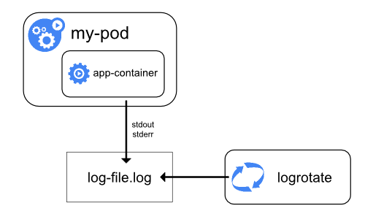
Node Level
Even though not an ideal solution it can do the job
We should pay attention to the following:
When a container is restarted, the kubelet keeps one terminated container with its logs
If a pod is evicted, all corresponding containers and their logs are deleted
We should set log rotation to do some housekeeping
Different container runtimes may have different requirements and capabilities
Not all system components are the same, so do their logs
Service based components log via systemd routines
Container based components use files in /var/log
https://kubernetes.io/docs/concepts/cluster-administration/logging/#logging-at-the-node-level

Slide 23
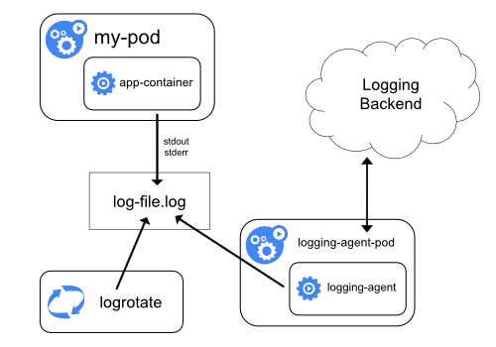
Node Logging Agent
This is considered cluster-level logging approach
For this, we deploy a node logging agent on each node
Typically, the logging agent is containerized and deployed via DaemonSet
The agent exposes the logs and pushes them to a backend
https://kubernetes.io/docs/concepts/cluster-administration/logging/#using-a-node-logging-agent

Slide 24
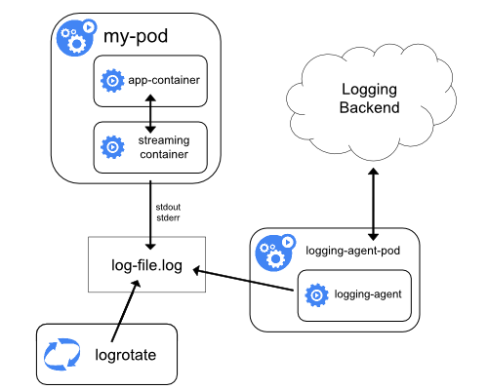
Streaming Sidecar and Logging Agent
This is considered cluster-level logging approach
The sidecar container is publishing the log to its stdout/stderr and thus making it available for the kubectl log command
Used to overcome limitations like separating multiple logs
We can have more than one sidecar container
https://kubernetes.io/docs/concepts/cluster-administration/logging/#streaming-sidecar-container

Slide 25
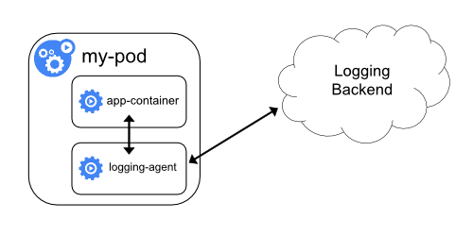
Sidecar with Logging Agent
This is considered cluster-level logging approach
Used when the node-level logging agent doesn’t agree well with the application
For this, we create a sidecar container with a logging agent that is especially configured and adjusted to the application’s needs
These logs are not consumable by the kubectl log command
https://kubernetes.io/docs/concepts/cluster-administration/logging/#sidecar-container-with-a-logging-agent

Slide 26
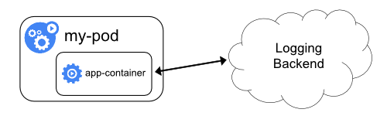
Exposed Directly from the Application
This is considered cluster-level logging approach
Every application pushes its logs to a backend
Simple solution which requires every application to support the common backend which may not always be feasible
https://kubernetes.io/docs/concepts/cluster-administration/logging/#exposing-logs-directly-from-the-application

Slide 27
Practice
Live Exercise in Class (Lab)
Notes:
27

Slide 28
Troubleshooting
Notes:
28

Slide 29
Troubleshooting
Not always everything is going according to plan and things break
The process of troubleshooting in Kubernetes is not that much different from other complex platforms
Here, we have two distinct domains – cluster and application
We should always check first the release notes for our version
Once we narrowed down the cause, we should start applying the corrective measures one at a time until the issue is resolved
https://kubernetes.io/docs/tasks/debug-application-cluster/troubleshooting/

Slide 30
Cluster Troubleshooting *
Common reasons include node power state, network connectivity, software version misalignment, data loss, bad configuration, etc.
First, we should check if all nodes are there and operational
Then, we must check the logs of the system components on the control plane and the workers
Keep in mind that depending on how a component is deployed (native service or container) the logs may be in different places
https://kubernetes.io/docs/tasks/debug-application-cluster/troubleshooting/

Slide 31
Application Troubleshooting *
First, we should define where exactly is the problem
Is it the service
It is not reachable
It is not returning what is expected
Or is it the workload object
What level and type of object
What is its state
https://kubernetes.io/docs/tasks/debug-application-cluster/troubleshooting/

Slide 32
Troubleshooting Pods
Start with describing the pod
Check the state of all containers inside the pod
If it is in pending state, then it cannot be scheduled on a node. Usually, this is because of lack of resources
If it is in waiting state, then it is scheduled, but still cannot run. Usually, this is because of a wrong or missing image
It is in running state but doesn’t behave as expected. Usually, this is because of a manifest error
https://kubernetes.io/docs/tasks/debug-application-cluster/troubleshooting/

Slide 33
Troubleshooting Services *
Does the service exist
Is it defined correctly
Are there any endpoints at all and how many
Are those pods working
Is the service reachable by DNS name and/or IP
Is the kube-proxy working
https://kubernetes.io/docs/tasks/debug-application-cluster/debug-service/

Slide 34
Practice
Live Exercise in Class (Lab)
Notes:
34

Slide 35
Questions?
Notes:
35

Slide 36










SoftUni Diamond Partners

Slide 37



Educational Partners

Slide 38

License
This course (slides, examples, demos, exercises, homework, documents, videos and other assets) is copyrighted content
Unauthorized copy, reproduction or use is illegal
© SoftUni – https://about.softuni.bg/
© Software University – https://softuni.bg
Notes:
38

Slide 39
Trainings @ Software University (SoftUni)
Software University – High-Quality Education, Profession and Job for Software Developers
softuni.bg, about.softuni.bg
Software University Foundation
softuni.foundation
Software University @ Facebook
facebook.com/SoftwareUniversity
Software University Forums
forum.softuni.bg
Notes:
39

